Slide 1
I recommend viewing these slides in full-screen mode (by clicking the “Slide show” icon: )

Slide 2
Parafoveal area
When we are looking at a word, we don’t only see the word we’re looking at (in what’s called the foveal area). In the corner of our eye, we can see (somewhat blurrily) nearby words as well, in what is called the parafoveal area. The following slides show some examples of what this looks like.

Slide 3
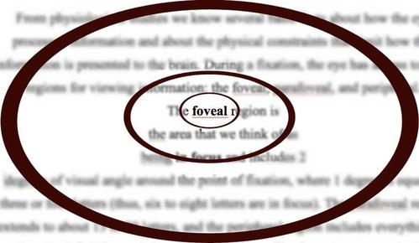

Image from online but website is no longer available

Slide 4
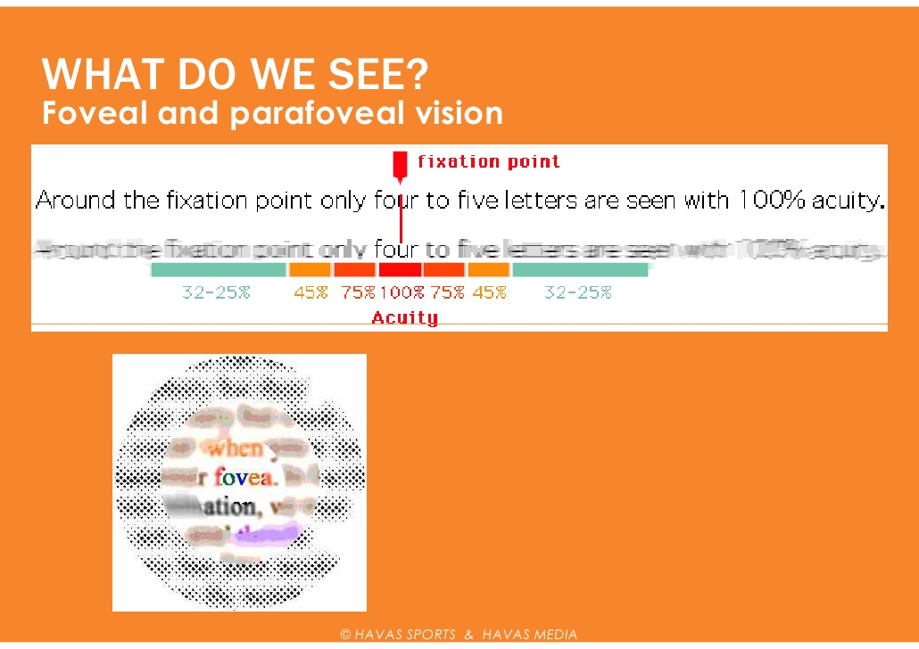
Image from online but website is no longer available

Slide 5
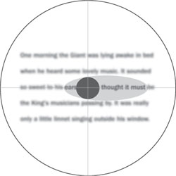
parafoveal
foveal
Image from https://www.nature.com/articles/nrneurol.2009.97

Slide 6
Parafoveal preview?
Do we get any useful information out of that blurry stuff we see in the parafoveal region?
In other words: Do we start to understand blurry words we see in the corner of our eye, before we even look at them?
Yan and colleagues (https://link.springer.com/article/10.1007%2Fs11145-010-9274-7) tested this question using eye-tracking. The following slides will summarize and demonstrate what they did.

Slide 7
Gaze-contingent boundary paradigm
When people are reading a sentence, one key word or character is temporarily covered by some other character.
At the instant before the person’s eyes move to that character, the “wrong” character gets replaced by the right character.
The following slides give an example of how this looks (in both traditional and simplified characters). The red character is the character we are interested in. You can imagine there is an invisible “boundary” (the blue line) before the critical character. The reader doesn’t see this boundary, but the computer knows it’s there. When the person’s eyes go past the boundary, the critical character changes into the correct one.

Slide 8
Here is what the sentence should be:
TARGET SENTENCE
许多人认为爱情是人类永恒而经典的话题之一。
許多人認為愛情是人類永恆而經典的話題之一。

Slide 9
Here is how the sentence will look before people’s eyes reach the critical character:
UNRELATED PREVIEW
许多人认为爱情是人类向恒而经典的话题之一。
許多人認為愛情是人類向恆而經典的話題之一。

Slide 10
Here is a demo. View the slide in full-screen mode and click through the animation to see. The blue asterisks represent where the person’s eye is looking. Notice how 向 changes into 永 just before the person looks at it.
许多人认为爱情是人类永恒而经典的话题之一。
許多人認為愛情是人類永恆而經典的話題之一。
许多人认为爱情是人类向恒而经典的话题之一。
許多人認為愛情是人類向恆而經典的話題之一。
*
*
*
*
*
*
*
*
*
*
*
*
*
*

Slide 11
That condition was called “unrelated preview” because the character shown before crossing the boundary (向) is unrelated to the real character (永). This condition is called “identical preview” because the real character (永) is shown even before people cross the boundary.
IDENTICAL PREVIEW
许多人认为爱情是人类永恒而经典的话题之一。
許多人認為愛情是人類永恆而經典的話題之一。

Slide 12
许多人认为爱情是人类永恒而经典的话题之一。
許多人認為愛情是人類永恆而經典的話題之一。
许多人认为爱情是人类永恒而经典的话题之一。
許多人認為愛情是人類永恆而經典的話題之一。
*
*
*
*
*
*
*
*
*
*
*
*
*
*

Slide 13
The logic of the experiment: When people have the “identical preview” they can see the character (in their parafoveal region, in the corner of their eye, where they just see it very blurry) before they actually look at it. When they have the “unrelated preview” they cannot see it before they look at it.
If people can understand words they see blurrily (in the parafoveal region at the corner of their eye), then that should give them a head start on understanding the character, so that when they really look at it they will understand it quickly, in the “identical preview” condition. On the other hand, in the “unrelated preview” condition, they didn’t have a chance to see the character in the corner of their eye, so when they actually look at it they should need more time to understand it.

Slide 14
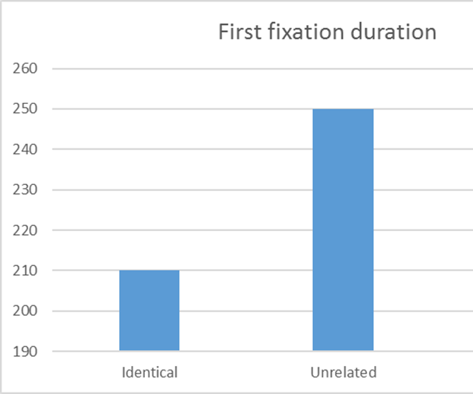
Results based on Yan, Risse, Zhou, & Kliegl (2012)

Slide 15
Those results suggest that people can at least partially recognize characters they see in the parafoveal region (because their first fixation on the character, when they really look at it, is shorter in the “identical preview” condition, where they had a chance to see the character parafoveally first).
But are they really understanding the character? Maybe they’re just recognizing the shape, but not starting to understand the meaning of the character.
Yan and colleagues tried another kind of sentence to test this.

Slide 16
Here, the “wrong” word that is shown before they cross the boundary (久) has a similar meaning as the real character (永)
SEMANTICALLY RELATED PREVIEW
许多人认为爱情是人类久恒而经典的话题之一。
許多人認為愛情是人類久恆而經典的話題之一。

Slide 17
许多人认为爱情是人类永恒而经典的话题之一。
許多人認為愛情是人類永恆而經典的話題之一。
许多人认为爱情是人类久恒而经典的话题之一。
許多人認為愛情是人類久恆而經典的話題之一。
*
*
*
*
*
*
*
*
*
*
*
*
*
*

Slide 18
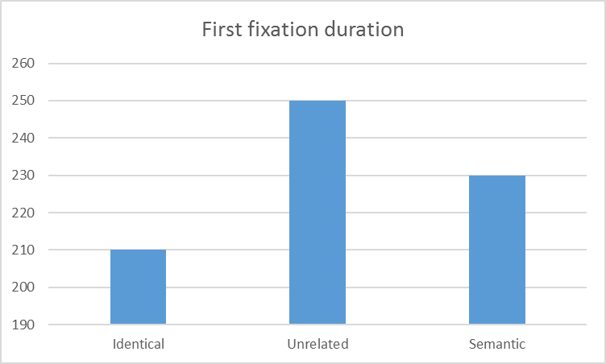
Yan, Risse, Zhou, & Kliegl (2012)

